Slide 1
Apache Kafka
Subramanian Murugan

Slide 2
Session Plan
What is topic
Partitioning
Add your third bullet point here

Slide 3
The events that Kafka Manages they have tendency to proliferate Just Think of What happened to you today since breakfast There are lot of events in the world. We need to organize them in the system , Now Kafka fundamental unit of event organization is called “Topic”

Slide 4
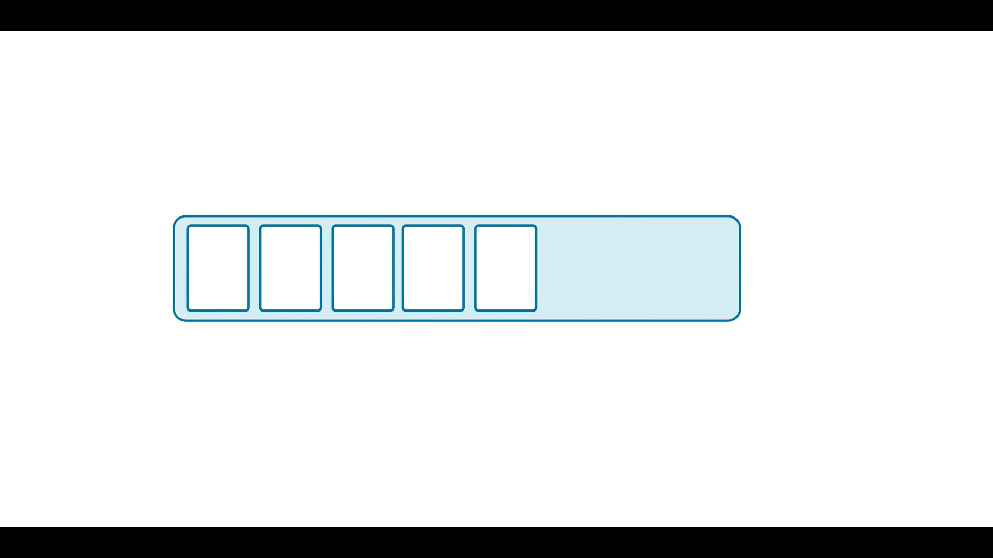

Slide 5
Topic is similar to database Tables

Slide 6
Topic
Named container for similar Events.
System can contain lot of topics
Can duplicate data between Topics
Transformed similar data
Topic is Durable logs of events
Logs are append only
When you write Message , you will go to end of the file
Can only seek by offset, not indexed
Events are immutable
Once events are produced cant be withdrawn.
Notes:
Topics can hold similar transformed data across the multiple topics, eg one topic can handle orders, where as another topic which filtered order data regarding cancelled orders.
Some people Topic is queue which is not right.
An offset into a file is simply the character location within that file, usually starting with 0; thus "offset 240" is actually the 241st byte in the file

Slide 7
Topics are Durable

Slide 8
Topics Retention period is configurable

Slide 9
Topics are behind the scene is just Files

Slide 10
Partitioning

Slide 11
If a topic were constrained to live entirely on one machine, that would place a pretty radical limit on the ability of Apache Kafka to scale. It could manage many topics across many machines—Kafka is a distributed system, after all—but no one topic could ever get too big or aspire to accommodate too many reads and writes. Fortunately, Kafka does not leave us without options here: It gives us the ability to partition topics.

Slide 12
Partitioning takes the single topic log and breaks it into multiple logs, each of which can live on a separate node in the Kafka cluster. This way, the work of storing messages, writing new messages, and processing existing messages can be split among many nodes in the cluster

Slide 13
Distributed System
Kafka Is distributed System.
It is Designed to operate across the number of computers and look to the outside world to you just writing code against single computer.
If a topic were constrained to live entirely on one machine one node in that cluster, it would be very hard to maintain.

Slide 14
What is Partitioning?
Partitioning takes single topic log , Just remind Topics are just logs.
Partitioning breaks it into multiple logs of each which can live in a separate node in the cluster.

Slide 15
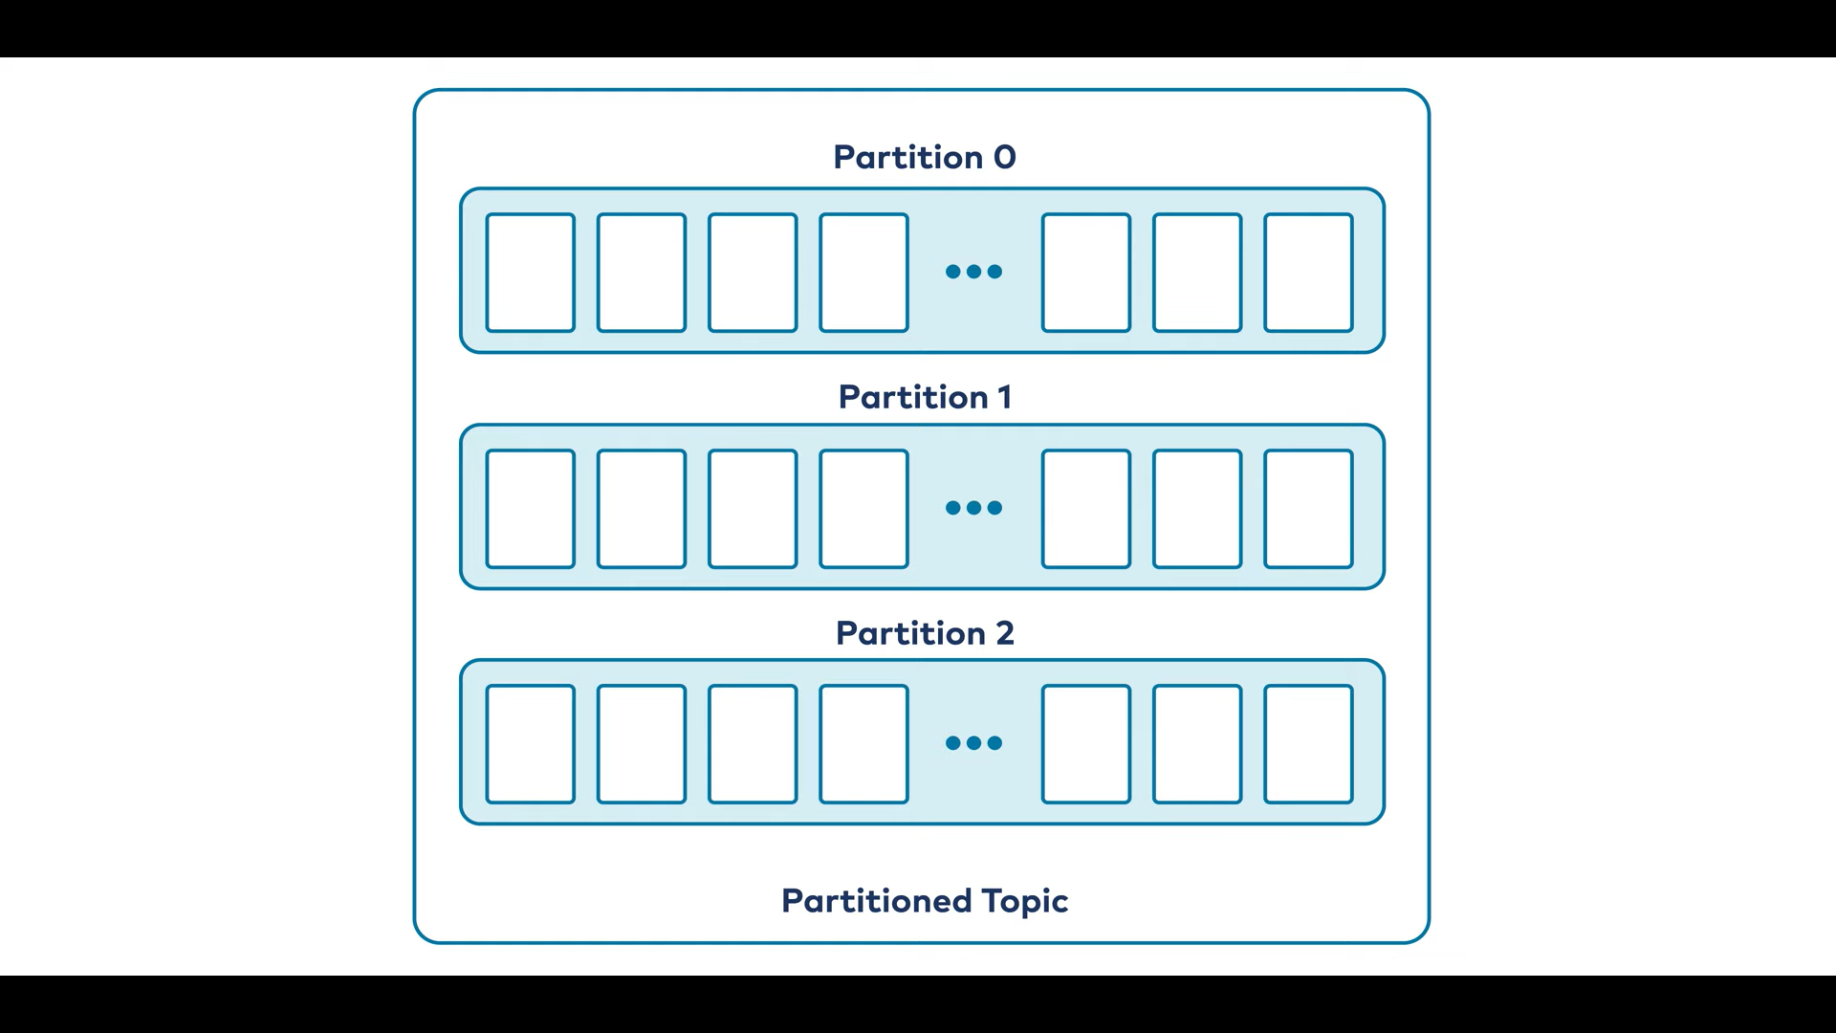

Slide 16
How Partitioning Works
Having broken a topic up into partitions, we need a way of deciding which messages to write to which partitions. Typically, if a message has no key, subsequent messages will be distributed round-robin among all the topic’s partitions. In this case, all partitions get an even share of the data, but we don’t preserve any kind of ordering of the input messages.
If the message does have a key, then the destination partition will be computed from a hash of the key. This allows Kafka to guarantee that messages having the same key always land in the same partition, and therefore are always in order.

Slide 17
For example, if you are producing events that are all associated with the same customer, using the customer ID as the key guarantees that all of the events from a given customer will always arrive in order. This creates the possibility that a very active key will create a larger and more active partition, but this risk is small in practice and is manageable when it presents itself. It is often worth it in order to preserve the ordering of keys.

Slide 18
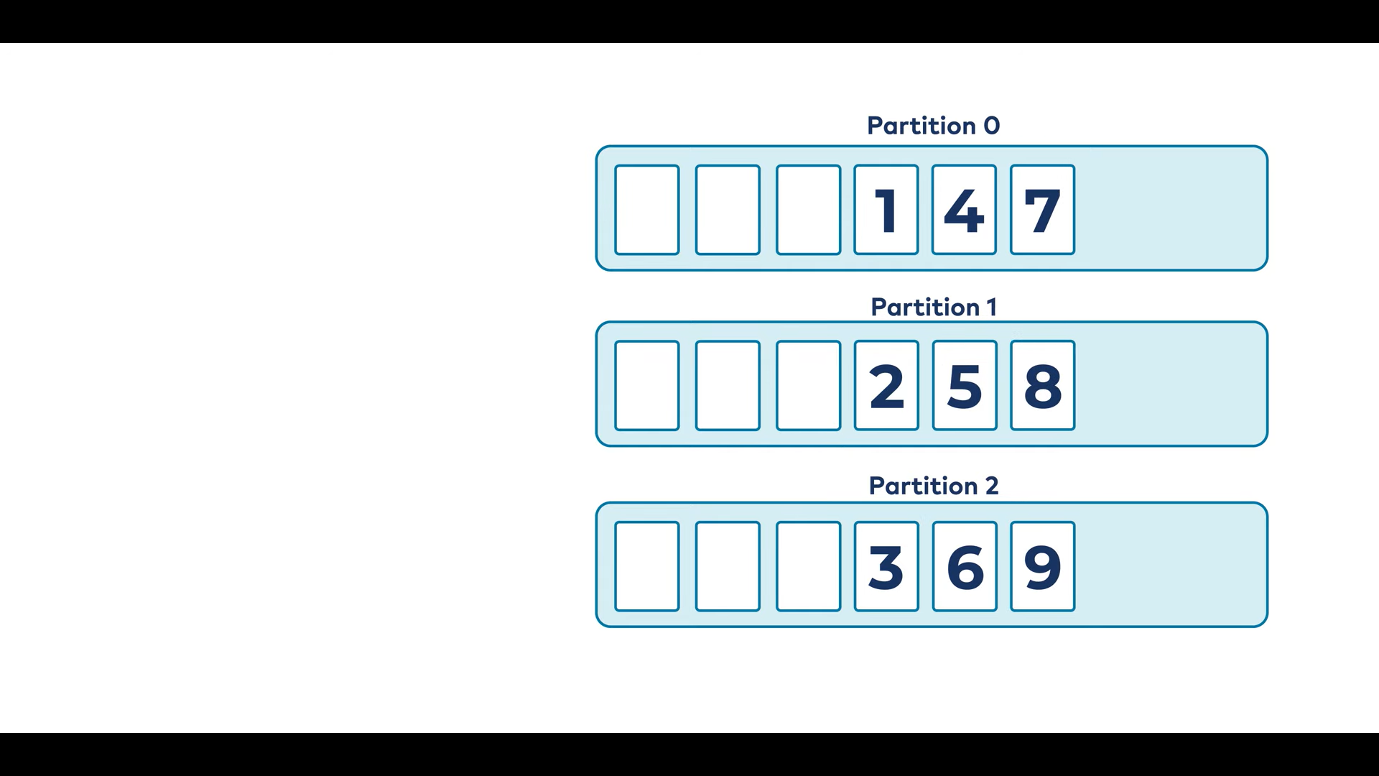

Slide 19
How to write Messages into partitions?
Since Topic is broken into multiple logs called partitions.
We write messages into topic, but now topic is broken into partitions.
How and Where to write messages into partitions?
We need to decide which message where to go.
If message has no key, Remember message is key-value pair
If the key is null or it is empty, messages are stored into partitions in the round robin fashion.

Slide 20
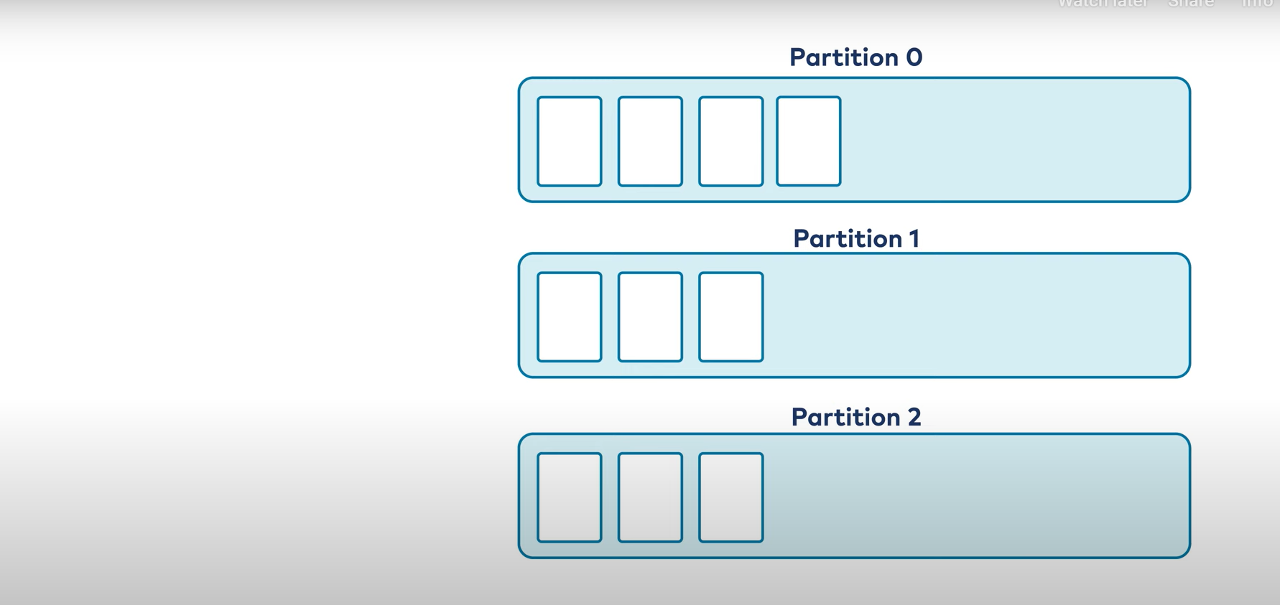

Slide 21
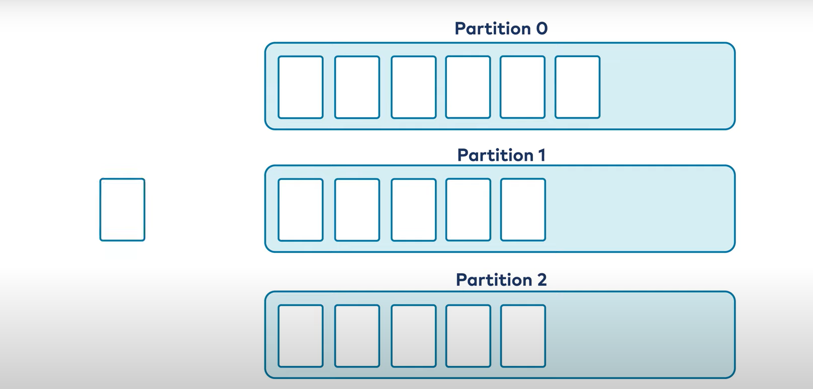

Slide 22
How to write Messages into partitions?
Having broken a topic up into partitions, we need a way of deciding which messages to write to which partitions. Typically, if a message has no key, subsequent messages will be distributed round-robin among all the topic’s partitions

Slide 23
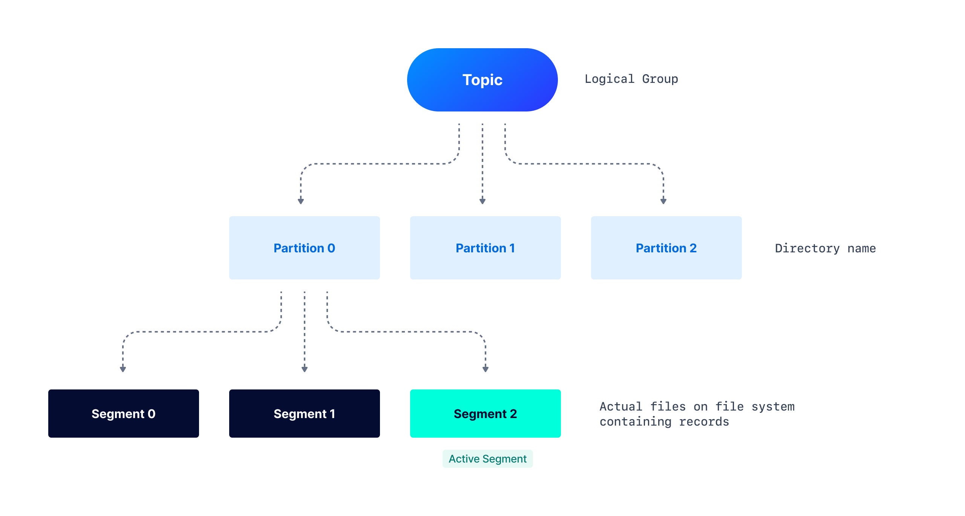

Slide 24
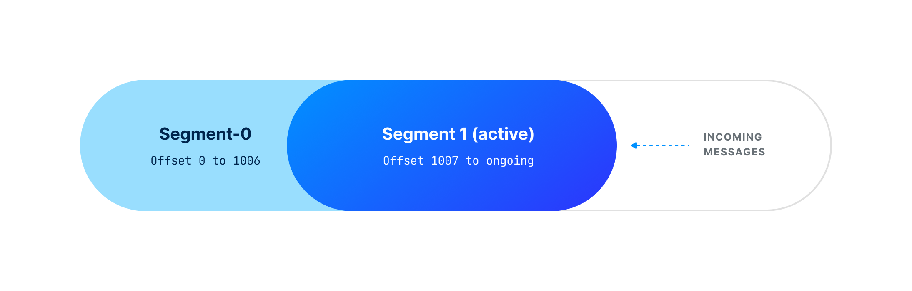

Slide 25
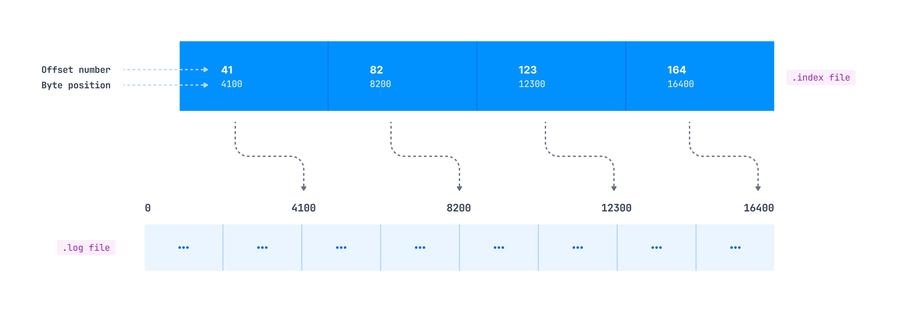
Index file

Slide 26
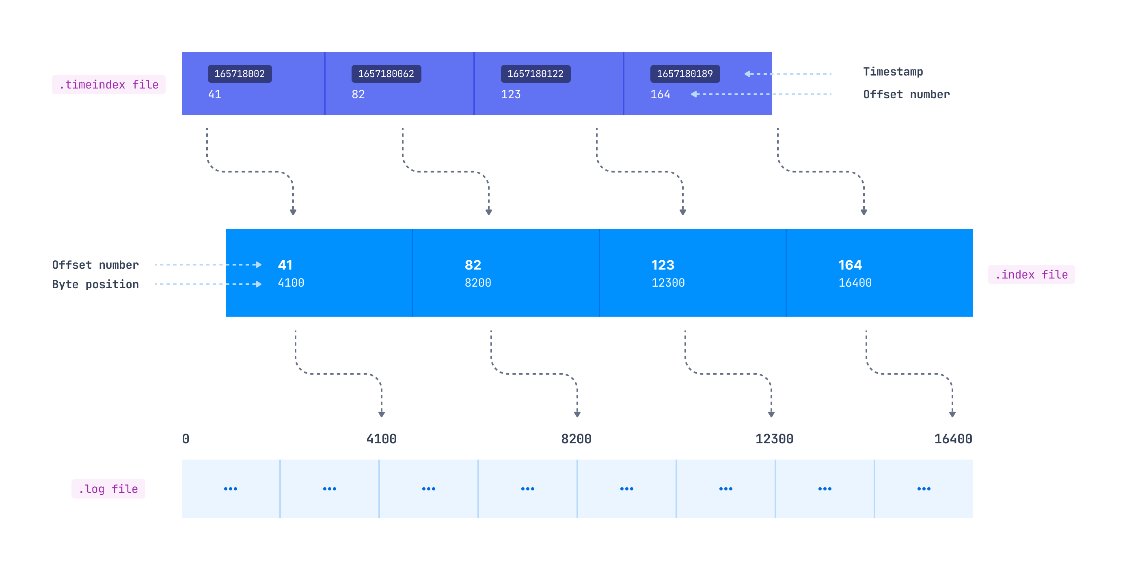

Slide 27
Indexing helps consumers to read data starting from any specific offset or using any time range.
the .index file contains an index that maps the logical offset to the byte offset of the record within the .log file.

Slide 28
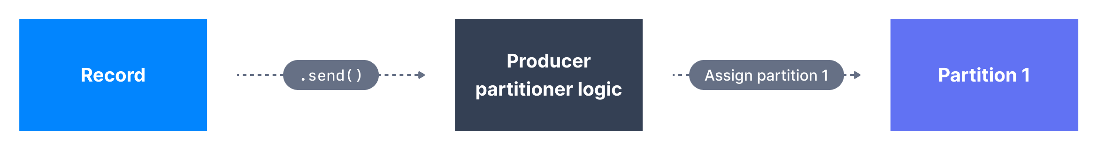
Producer

Slide 29
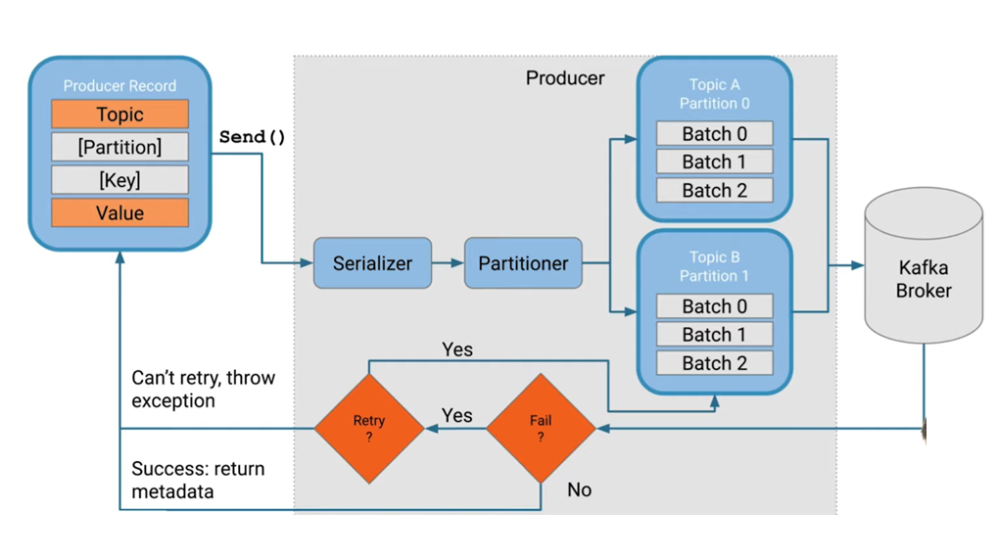

Slide 30
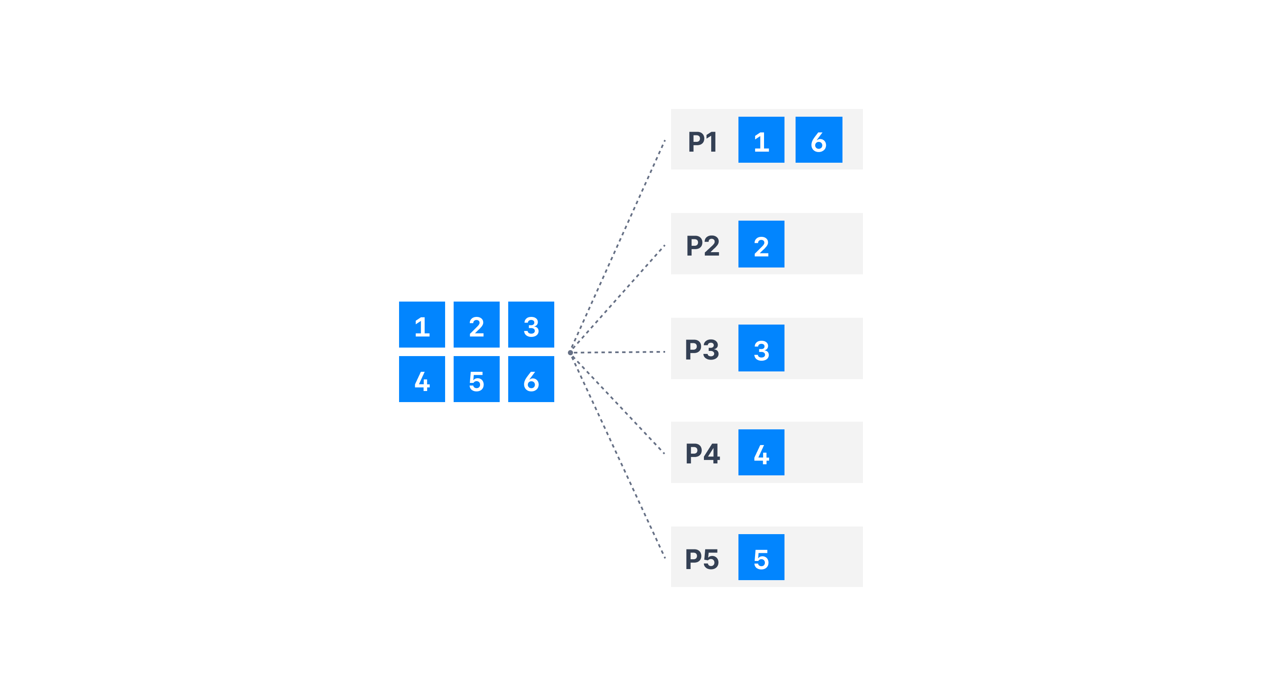
Round Robin Partitioner (Kafka ≤ v2.3)

Slide 31
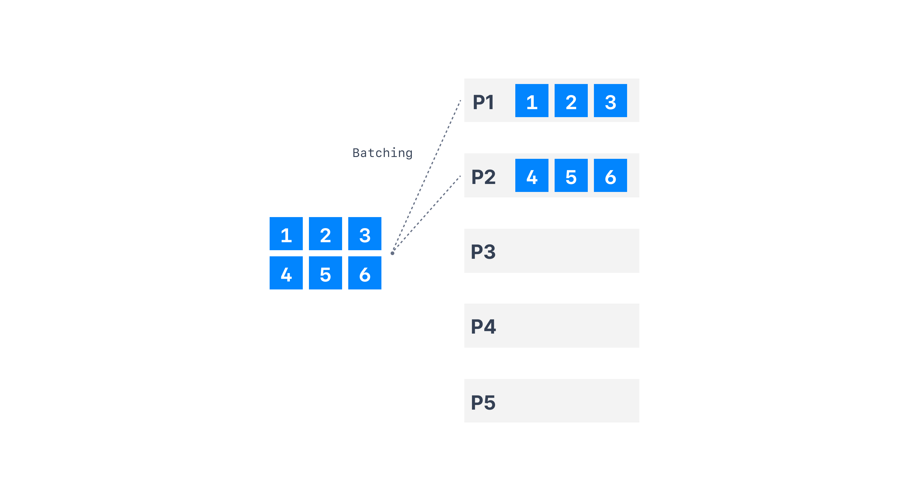
Sticky Partitioner

Slide 32
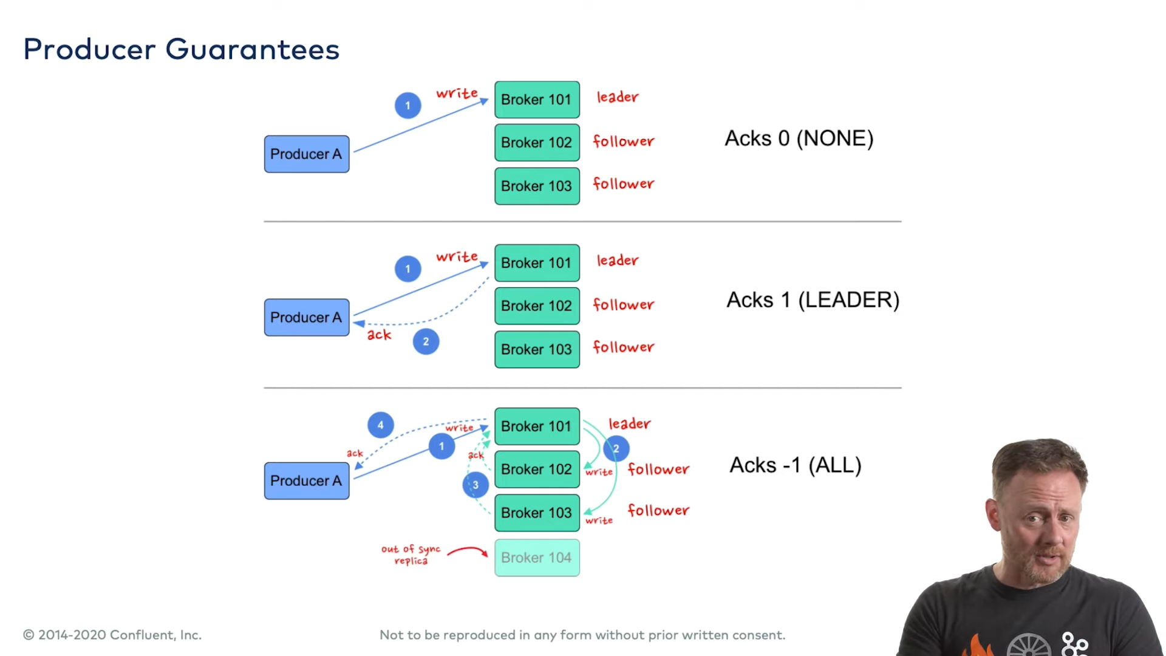

Slide 33
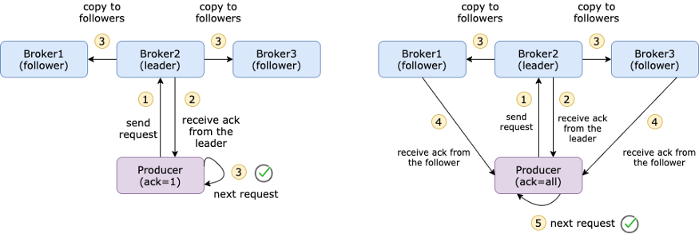

Slide 34
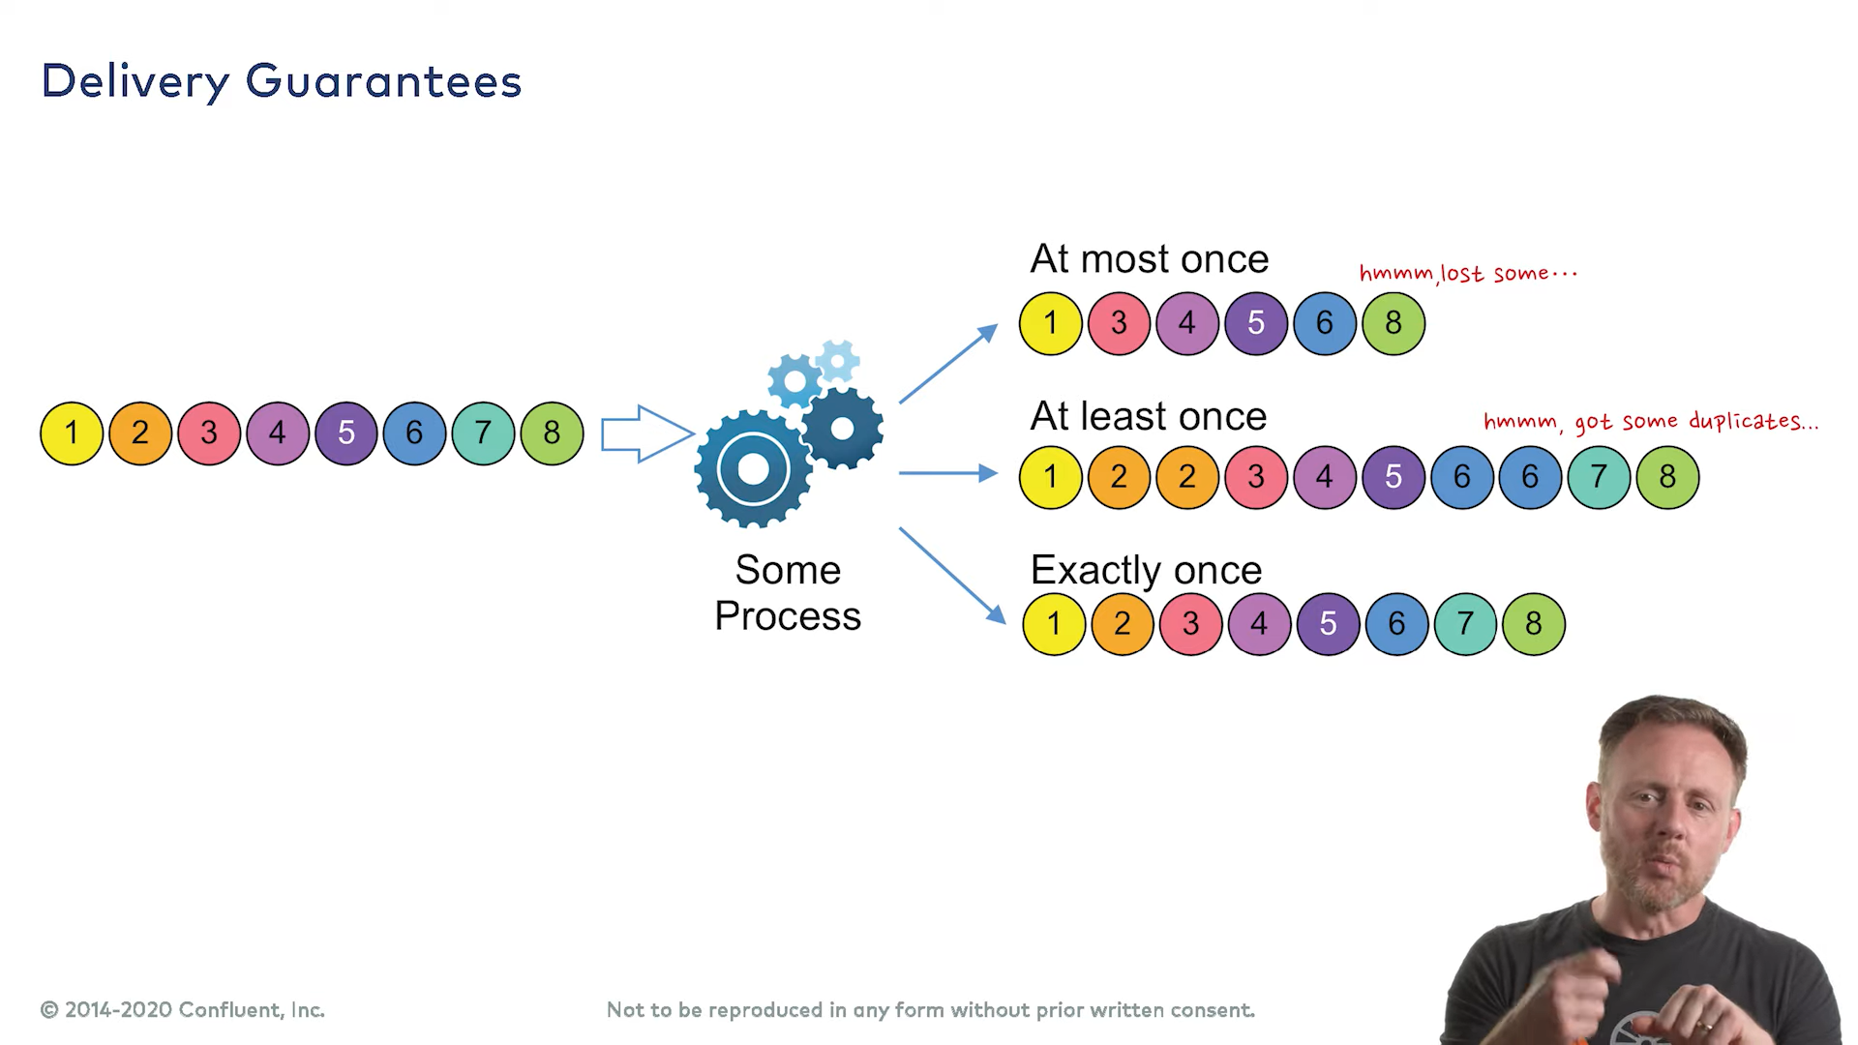

Slide 35
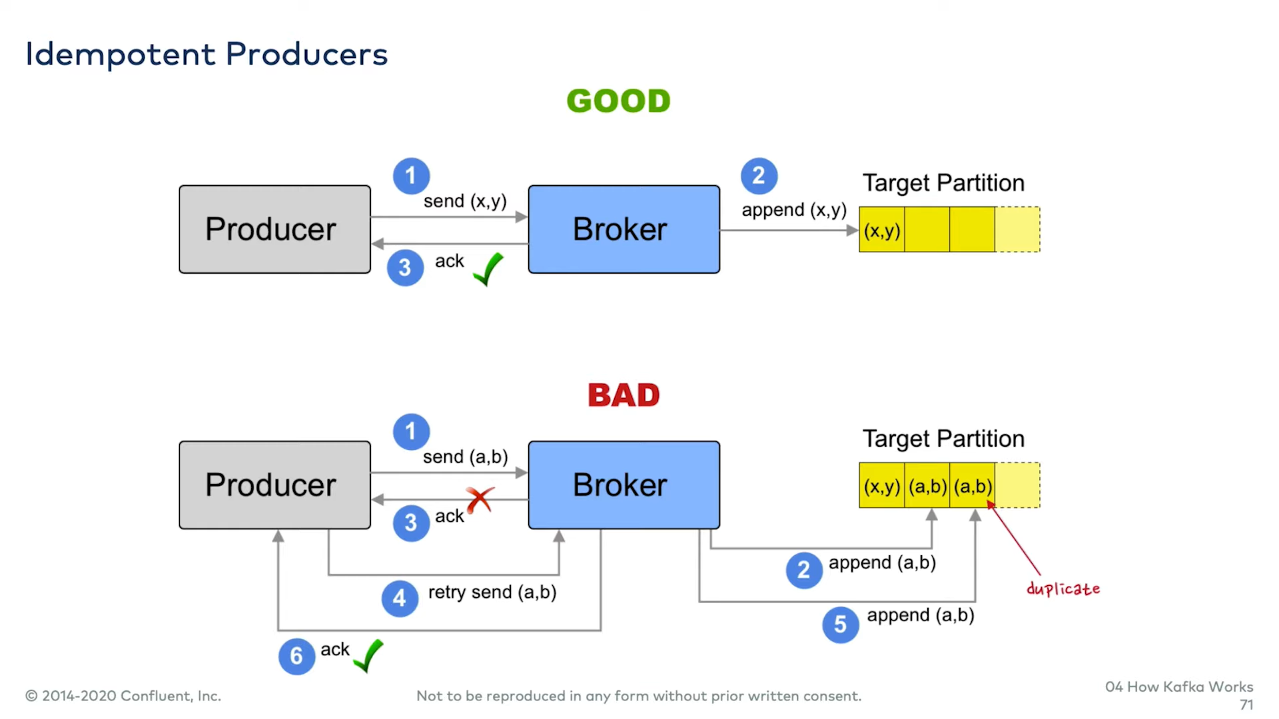

Slide 36
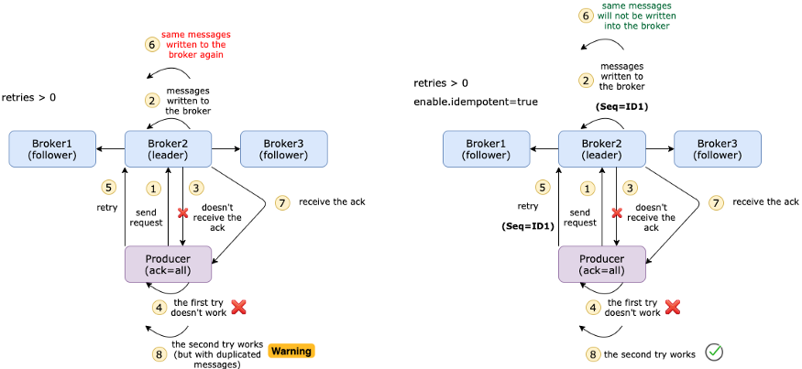

Slide 37
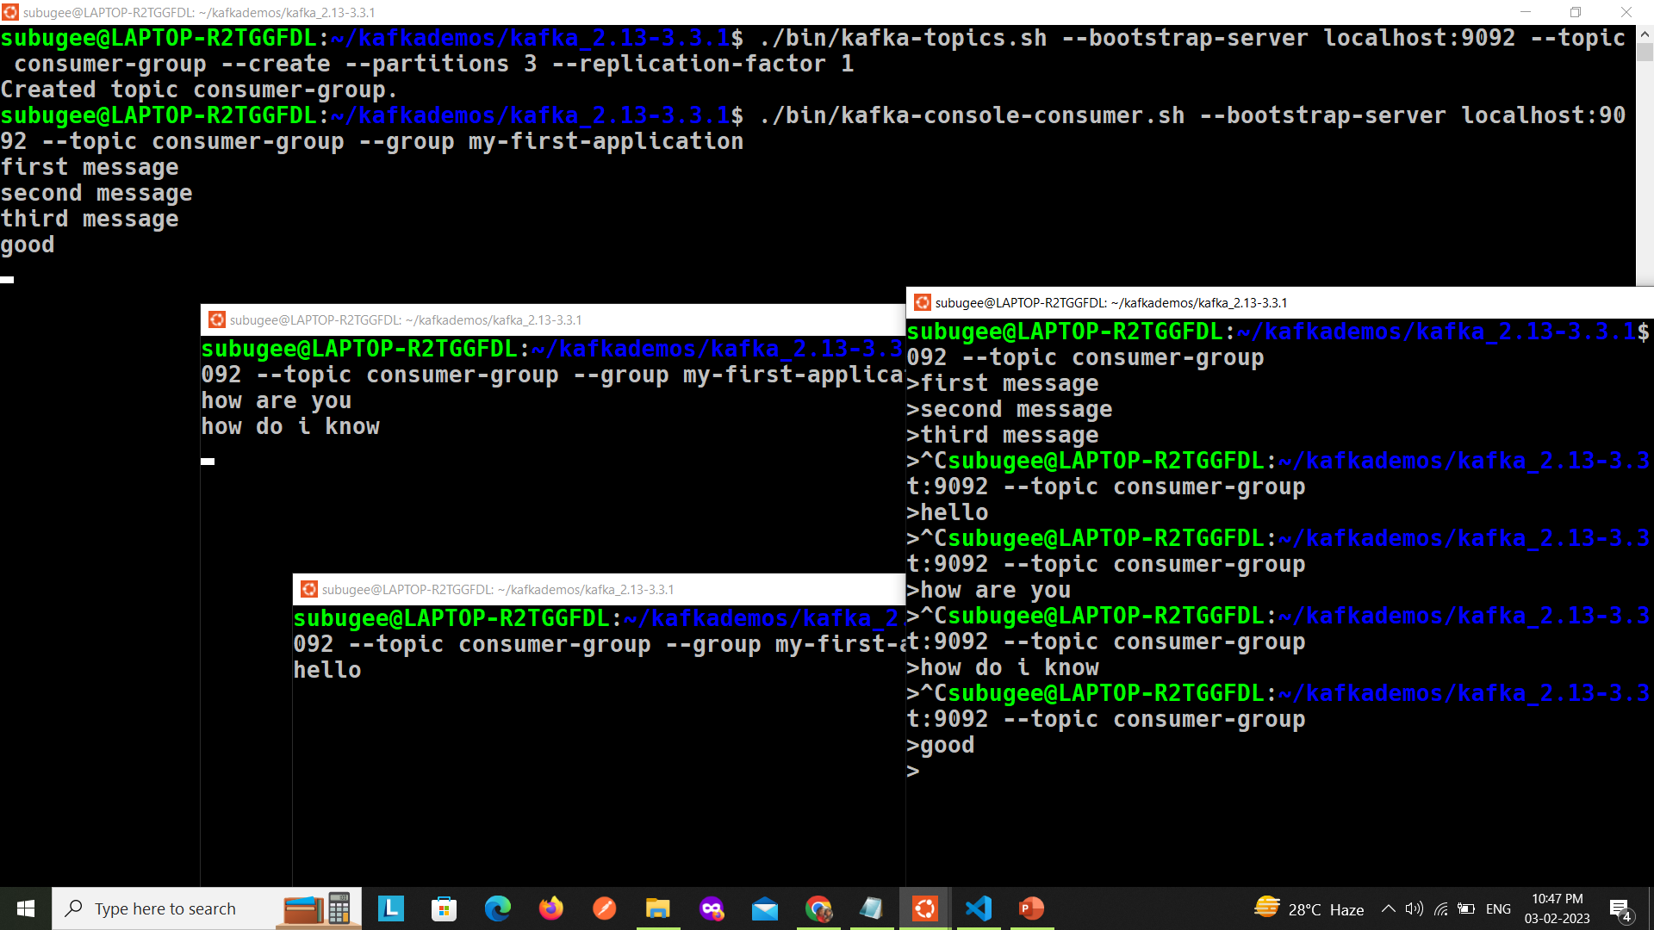
Consumer group

Slide 38

Thank you

